Slide 1
Enhanced Resolution Chirped Pulse Interferometry
Madeleine (Maggie) Bérubé
February 26th, 2025

Slide 2

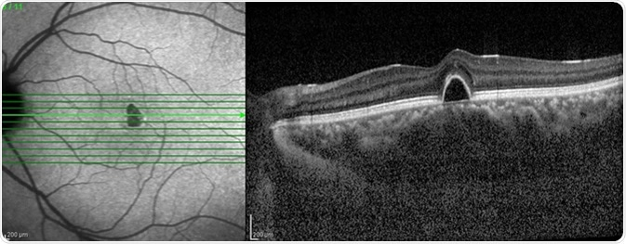

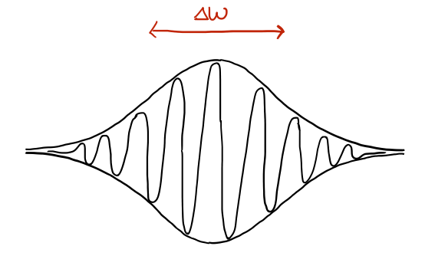

Interferometry
Uses the interference of light sources to make precise measurements
White light interferometry → Absolute time delay
Interferometer diagram
Optical Coherence Tomography (OCT)
https://www.news-medical.net/health/What-is-Optical-Coherence-Tomography.aspx
Notes:
OCT is a non-invasive medical imaging technique – good for eyeball scans without cutting into the eye!

Slide 3



Signal resolution and dispersion
coherence time, $τ_{coh}\sim \frac{1}{∆ω}$
Small coherence time → better resolution
Small coherence time → increased sensitivity to dispersion
(frequency-dependent speed of light)
Notes:
Small coherence time = broad spectrum
Dispersion degrades the resolution of the signal
Dispersion: speed of light in a material (glass) is freq dep (blue light is slower than red)

Slide 4
Types of interferometers
Classical methods
Quantum methods
White Light Interferometer (WLI)
Chirped Pulse Interferometer (CPI)
Hong-Ou-Mandel Interferometer (HOM)
Sensitive to dispersion
Dispersion cancellation
Dispersion cancellation
?

Slide 5
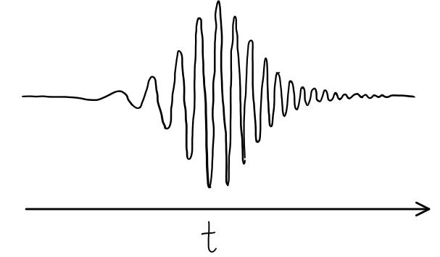
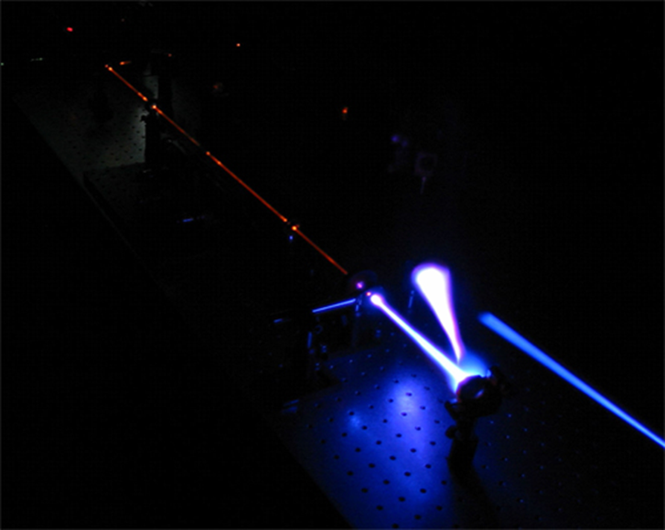
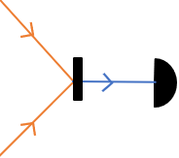
Chirped Pulse Interferometry
A chirped pulse is a signal where the frequency changes with time
Sum-frequency generation (SFG)
2nd harmonic generation
https://www.desy.de/f/students/2007/studsess/guzman.pdf
Notes:
Linear chirp : frequency varies linearly with time
Non-linear chirp : frequency varies with time in some other way (quadratic, exponential, etc.)
SFG is a non-linear optics method that combines two pulses as the product of their intensities

Slide 6
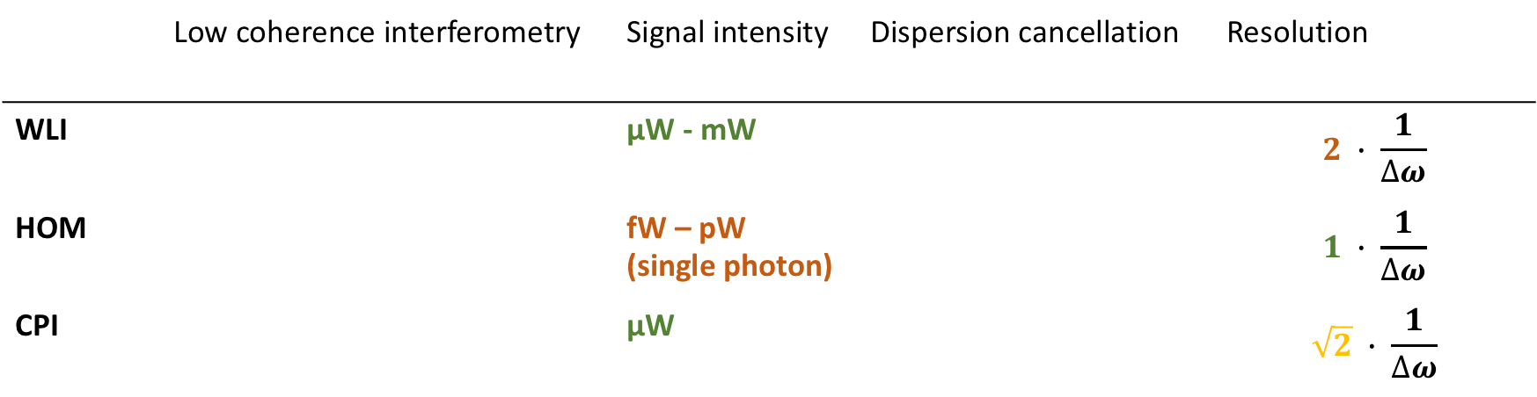
White light interferometer technologies
 | Low coherence interferometry | Signal intensity | Dispersion cancellation | Resolution
WLI |  | μW - mW |  | $$2 ∙ \frac{1}{∆ω}$$
HOM |  | fW – pW (single photon) |  | $$1 ∙ \frac{1}{∆ω}$$
CPI |  | μW |  | $$\sqrt{2} ∙ \frac{1}{∆ω}$$
Last term: Can we improve this?
Error function phase -> non-linearly chirped pulse
Notes:
Click for transition
Difference in resolution has been suggested as the remaining quantum advantage

Slide 7
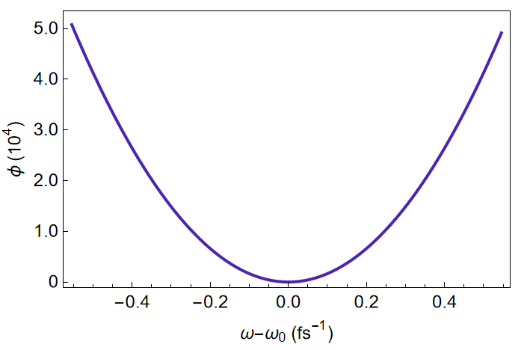
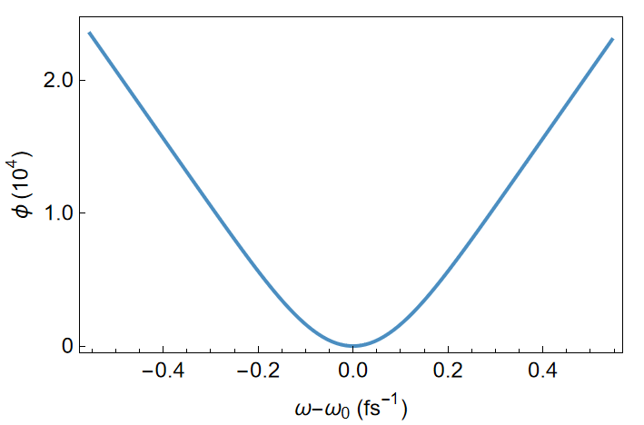
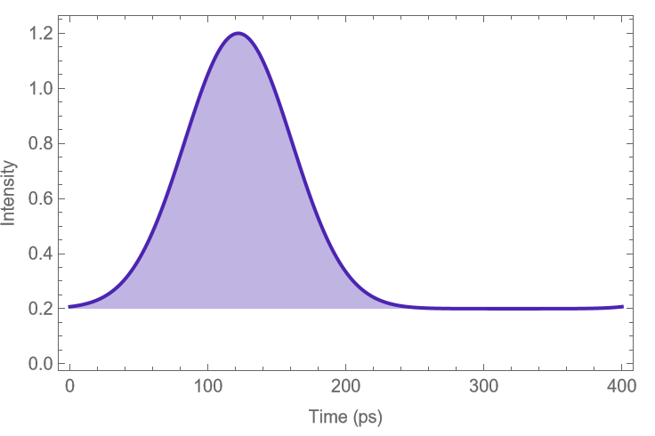
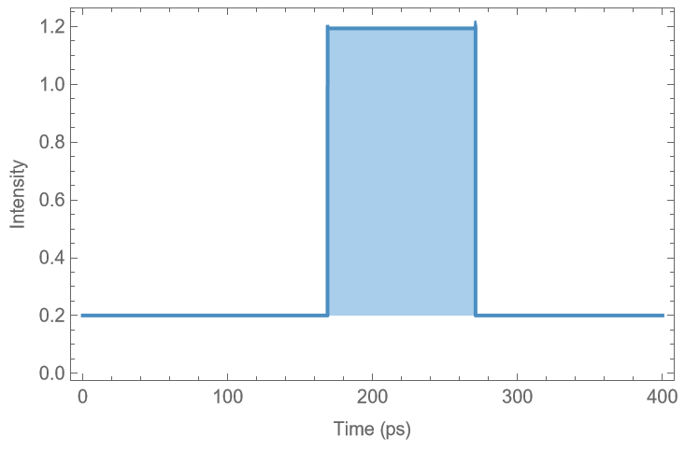
Regular and Erf chirp
Phase functions
quadratic
error funct.
Gaussian
Top-hat
Chirped pulses

Slide 8
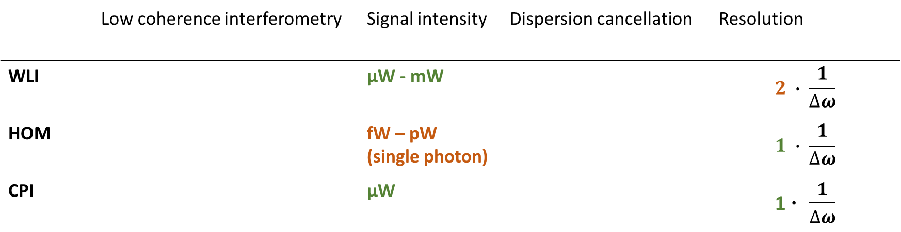
White light interferometer technologies
 | Low coherence interferometry | Signal intensity | Dispersion cancellation | Resolution
WLI |  | μW - mW |  | $$2 ∙ \frac{1}{∆ω}$$
HOM |  | fW – pW (single photon) |  | $$1 ∙ \frac{1}{∆ω}$$
CPI |  | μW |  | 1 $∙ \frac{1}{∆ω}$
This term: Can we improve this?
Notes:
Click for transition
Why stop at 2?

Slide 9
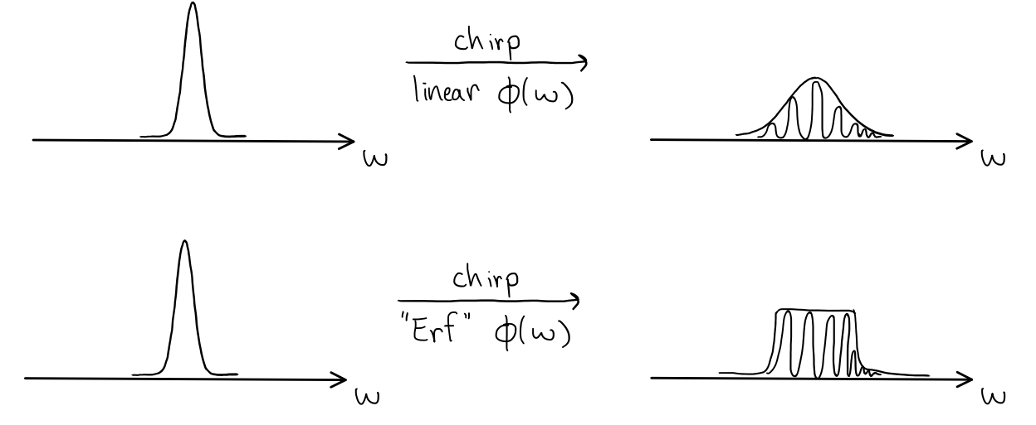

Improving the $\sqrt{2}$
more contribution
less contribution
How can we improve this?
equal contribution
Notes:
Click for transition
We chirp the pulses by applying a phase, phi(w)
When we combine the two chirped pulses, the middle part overweighs the edges, creating a signal that is proportional to sqrt(2)
this is an annoying difference between the quantum and classical system and has been suggested as a quantum advantage -- can we show that it isn’t?
To do this, we need to create a chirped pulse that has equal contribution across all frequencies, which is achieved using a phase function proportional to an error function, hence “erf” chirp.

Slide 10
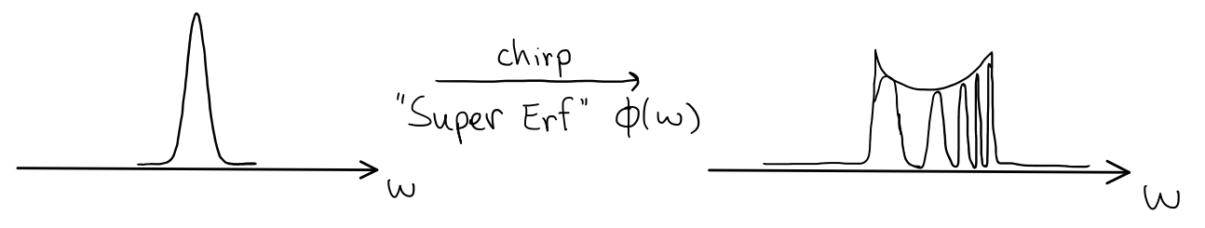

Improving the $1$
equal contribution
How can we improve this?
less contribution
more contribution
Notes:
Click for transition
We chirp the pulses by applying a phase, phi(w)
When we combine the two chirped pulses, the middle part overweighs the edges, creating a signal that is proportional to sqrt(2)
this is an annoying difference between the quantum and classical system and has been suggested as a quantum advantage -- can we show that it isn’t?
To do this, we need to create a chirped pulse that has equal contribution across all frequencies, which is achieved using a phase function proportional to an error function, hence “erf” chirp.

Slide 11
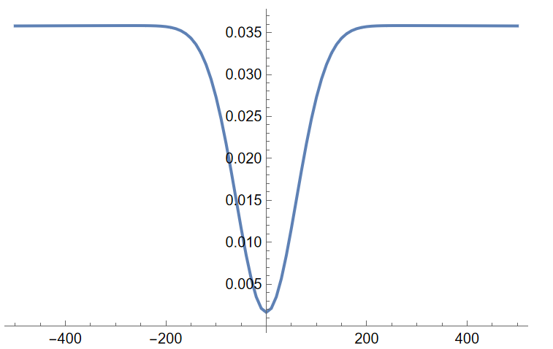
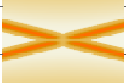
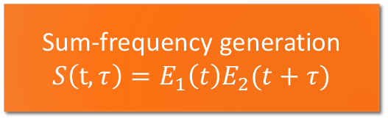

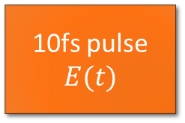
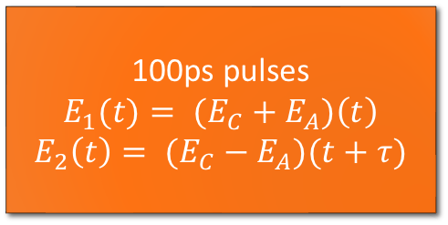

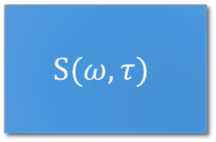
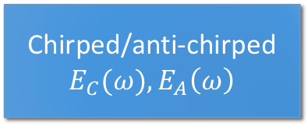


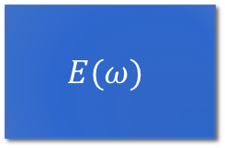
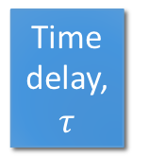
Calculating CPI resolution
10fs pulse
$$E(t)$$
FFT
$$E(ω)$$
$$φ(ω)$$
Chirped/anti-chirped
$$E_{C}(ω), E_{A}\left(ω\right)$$
Time delay, $τ$
$$+$$
Inverse FFT
100ps pulses
$${E_{1}(t)= (E}_{C}+E_{A})\left(t\right)$$
$${E_{2}\left(t\right)= (E}_{C}−E_{A})(t+τ)$$
Sum-frequency generation
$$S\left(t, τ\right)=E_{1}\left(t\right)E_{2}(t+τ)$$
$$S(ω, τ)$$
Non-linear optics
FFT
Integrate about $2ω_{0}$
$$S\left(τ\right) \text{vs} τ$$
Notes:
Many step process that involves fourier transforms, applying phases and time delays, linear combinations of pulses, non-linear combination of pulses, and integration

Slide 12
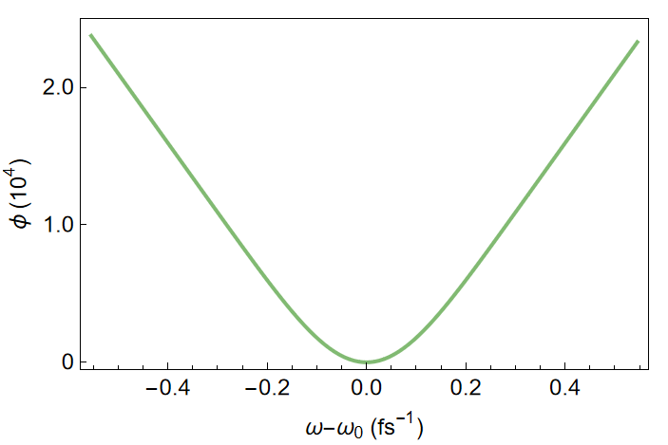
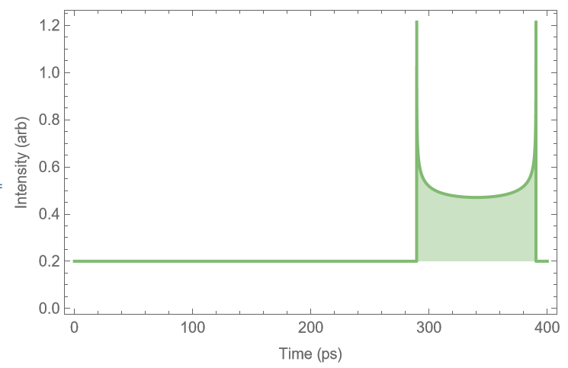
Super erf chirp
Modified erf phase funct.
“Super” erf chirped pulse

Slide 13
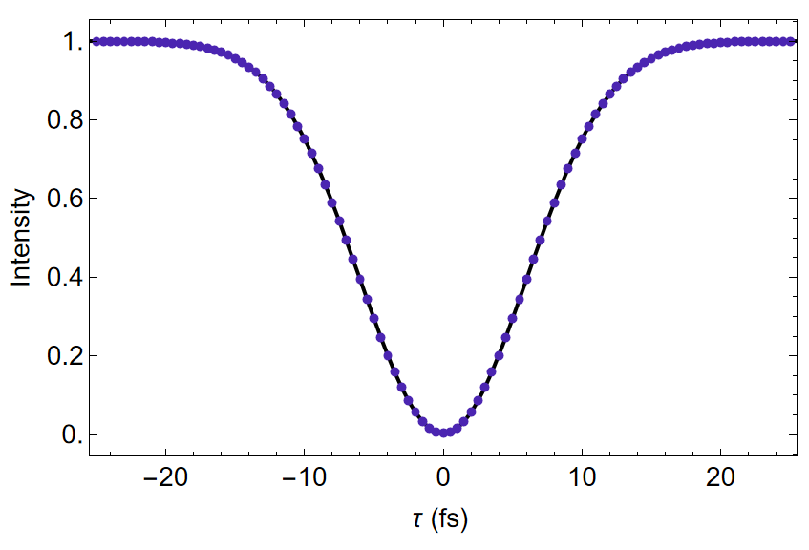
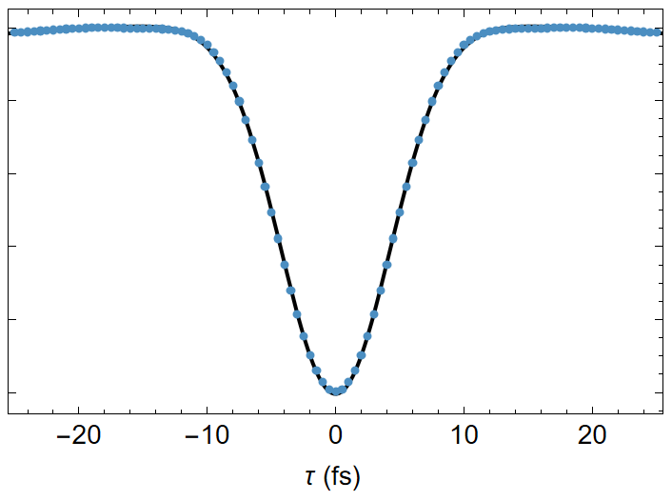
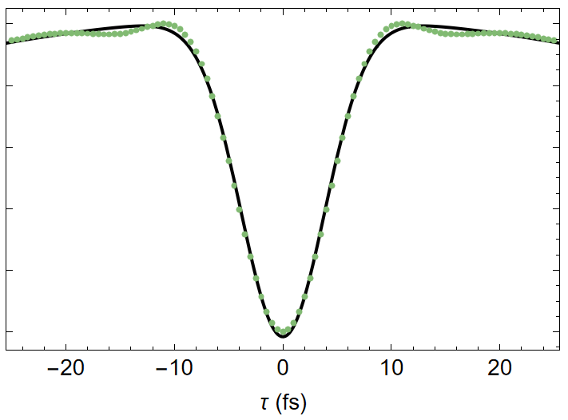
Comparison of widths
Starting pulse width: 10fs
Non-linear CPI,
modified phase function
Linear CPI
Non-linear CPI
14.14 fs
10.09 fs
9.08 fs

Slide 14
Next steps
Better understanding of the non-linear CPI methods’ response to dispersion
Investigate a realistic model of what this would look like in a lab set-up (spatial light modulators)
Thank you!
Questions?

Slide 15
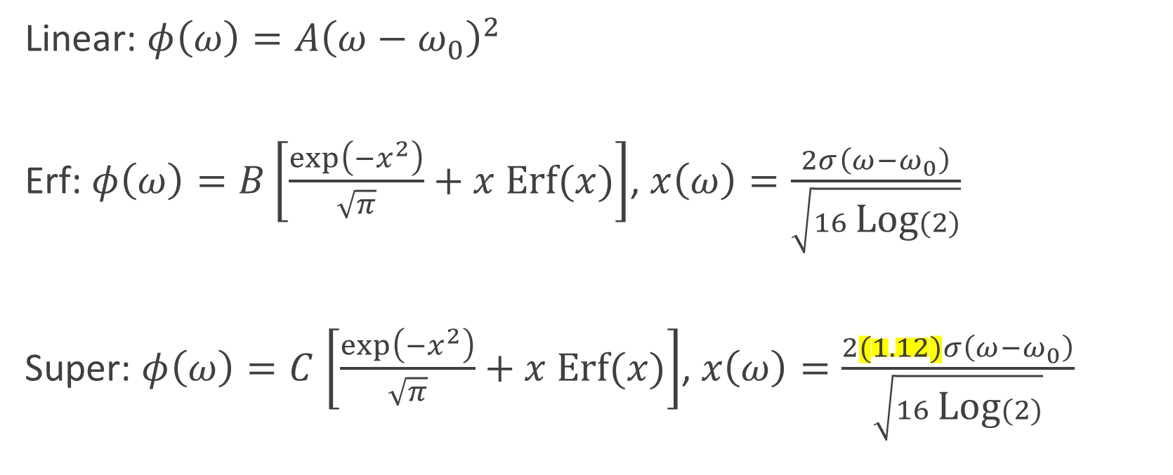
Phase functions
Linear: $φ\left(ω\right)=A{\left(ω−ω_{0}\right)}^{2}$
Erf: $φ\left(ω\right)=B\left[\frac{\exp\left(−x^{2}\right)}{\sqrt{π}}+x \text{Erf}(x)\right]$, $x\left(ω\right)=\frac{2σ\left(ω−ω_{0}\right)}{\sqrt{16 \text{Log}(2)}}$
Super: $φ\left(ω\right)=C$ $\left[\frac{\exp\left(−x^{2}\right)}{\sqrt{π}}+x \text{Erf}(x)\right]$, $x\left(ω\right)=\frac{2(1.12)σ\left(ω−ω_{0}\right)}{\sqrt{16 \text{Log}(2)}}$

Slide 16
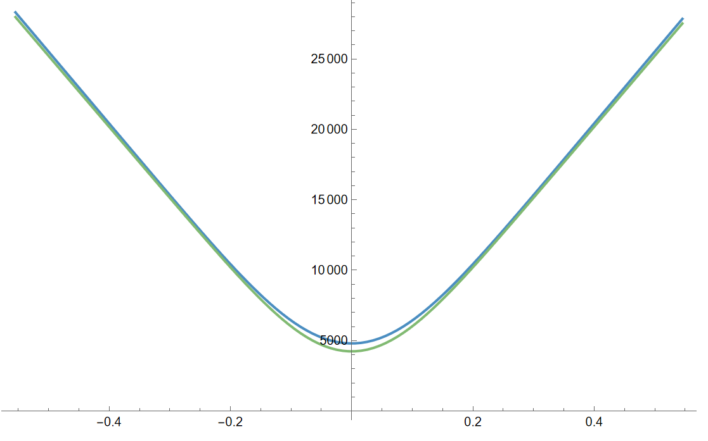
Comparing erf and super erf phase functions

Slide 17
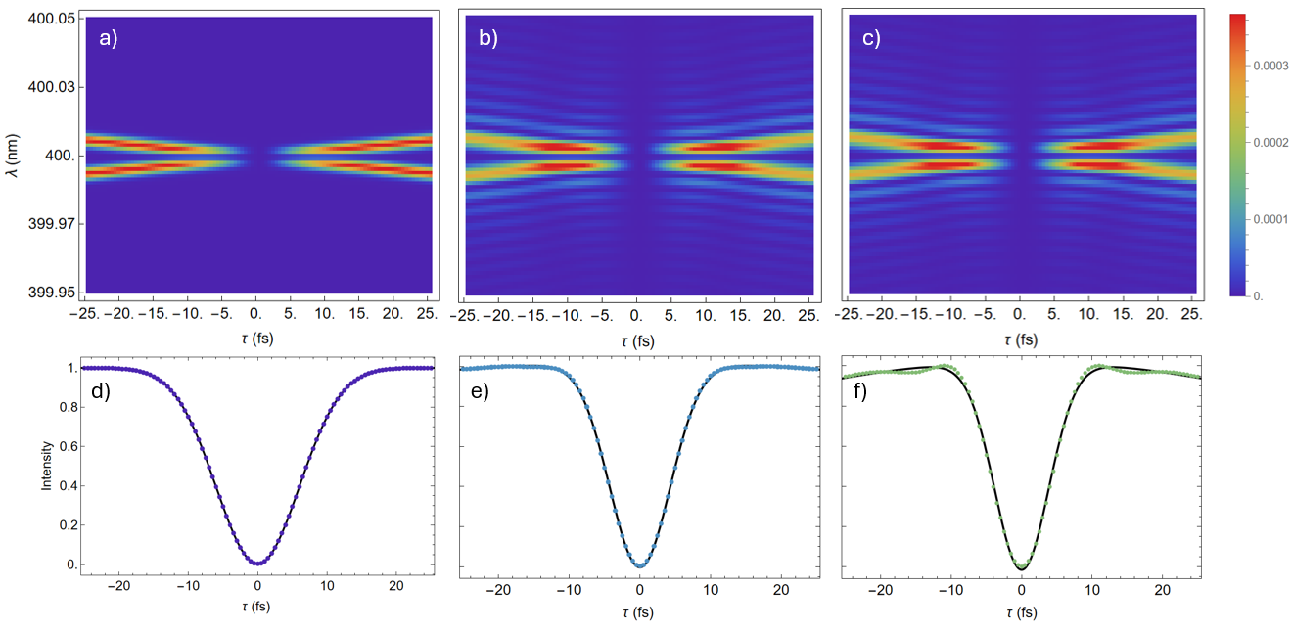
Recreating linear and erf chirp signals
1. Calculate the intensity of the signal as a function of time delay to get the SFG spectrum
2. Sum the intensities at each time value to get the intensity signal
3. Fit the signals with a gaussian to extract the width
Notes:
Axes not done

Slide 18
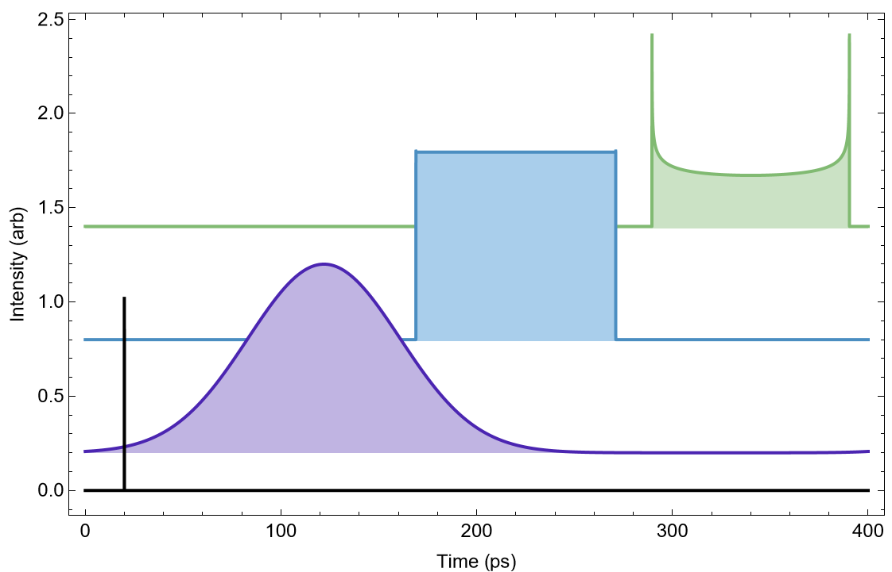
Pulse shapes
Notes:
Pulses have the same spectrum (the same colours) but a different phase results in different intensity in time

Slide 19



Interferometer diagrams
sample
$$L$$
$$σ$$
$$τ$$
detector

Slide 20











Interferometer diagrams
sample
$$L$$
sample
$$L$$
SFG
SPDC
detector
detector
$$τ$$
$$τ$$
$$σ$$
CPI

Slide 21
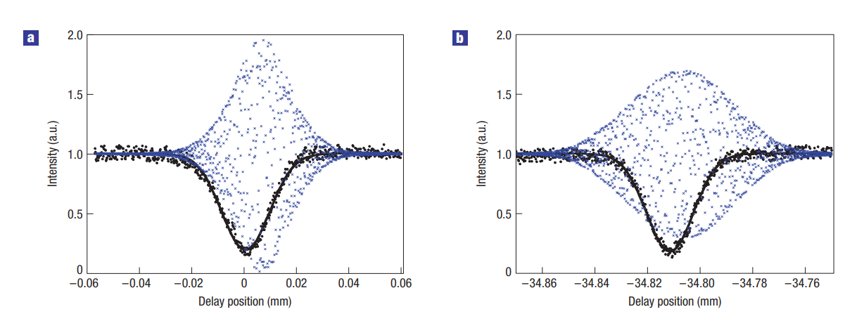
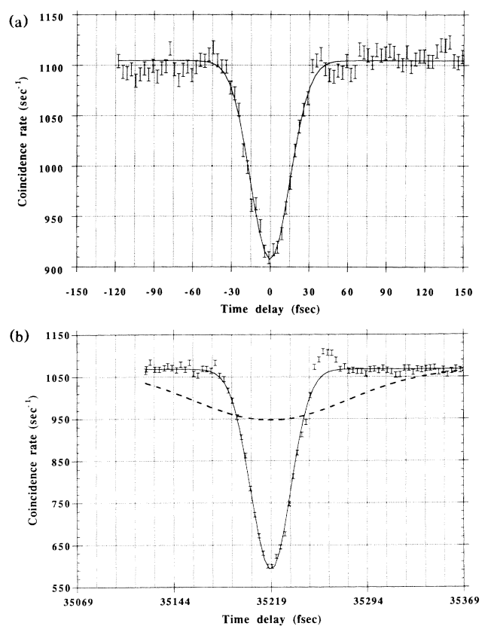
Dispersion cancellation
WLI is sensitive to dispersion, Chirped Pulse Interferometry (CPI) and Hong-Ou-Mandel Interferometry (HOM) are not
CPI
HOM
No dispersion
With dispersion
Ref [1]
Ref [2]
Notes:
What this means is that the resolution of the signal for CPI and HOM are not affected by dispersion, but the white light one gets worse
CPI uses chirped pulses, HOM uses energy entangled photons (from SPDC)
Dispersion cancellation was originally thought to be a quantum effect only, but Prof Resch’s group showed that classical systems can have it too

